Slide 1
Project 3: Generation of Renewable Energy from Food Waste
Emily Hoffman - Dixie Heights High School
Jillian Richmond - Scarlet Oaks High School
RET is funded by the National Science Foundation, grant # EEC-1404766.

Slide 2
Project Outline
Abstract
Background
Goals and Objectives
Training
Methodology
Research Tasks
Timeline
Results for Experiment 1
Unit Plans

Slide 3
Abstract
Purpose
Determining ratio of food waste to primary sludge
Relationship to climate change
Methane gas as energy

Slide 4
Background
In 2013, the US disposed more than 35 million tons of food waste.
The average household waste $2,275 worth of groceries every year
24% of the food wasted is Fruits and Vegetables
Landfills v. Composting
(2015) “Reducing food waste basics.” EPA, <http://www2.epa.gov/recycle/reducing-wasted-food-basics> (Jun. 29, 2015)
Giesler, Jennifer. (2012) “Nationwide Food Waste.” <http://portfolios.scad.edu/gallery/5938833/Nationwide-Food-Waste-Infograpic> (Jun. 29, 2015)

Slide 5
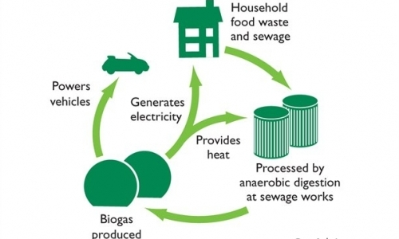
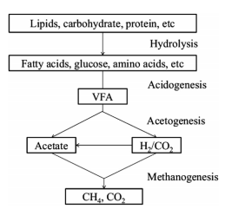
Anaerobic Digestion Process
(
2015) “Food Waste Recycling.” GenEco, <http://www.geneco.uk.com/Food-waste-recycling/Process.aspx> (Jun. 29, 2015)

Slide 6
Goals and Objectives
Objective 1: To optimize the ratio of food waste to primary sludge for maximum methane generation
Objective 2: To study the stability of the anaerobic digestion process when food waste and primary sludge are used as substrates

Slide 7
Training
Experimental set up
BMP Serum Bottle Test
Analytical
pH
Total and Volatile Suspended Solids
Chemical Oxygen Demand
Analysis of Ammonia
GC-TCD (CH4 and CO2)
GC-FID (Volatile Fatty Acids)

Slide 8
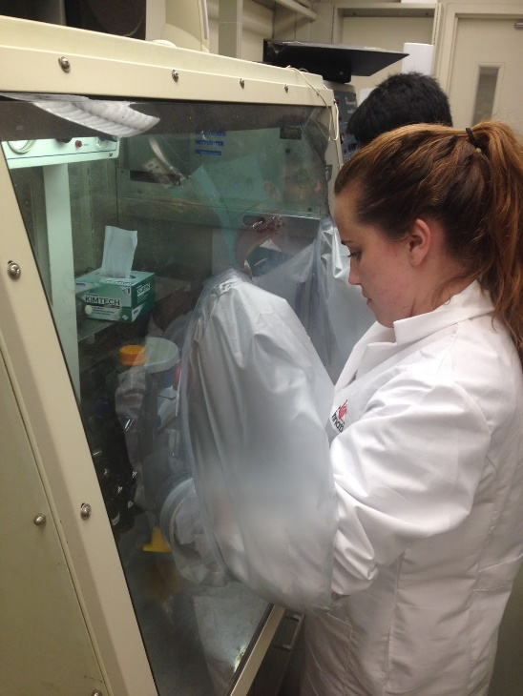
Methodology
Experiment | Ratio A | Ratio B | Ratio C
1 (Without Buffer) | 1:3 | 1:1 | 1:9
2 (Buffer) | 1:3 | 1:1 | 1:9
Controls | FW only | PS only | I only
FW - Food Waste obtained from Center Court (UC)
PS - Primary Sludge obtained from Fairfield WWTP
I - Inoculate obtained from Fairfield WWTP

Slide 9
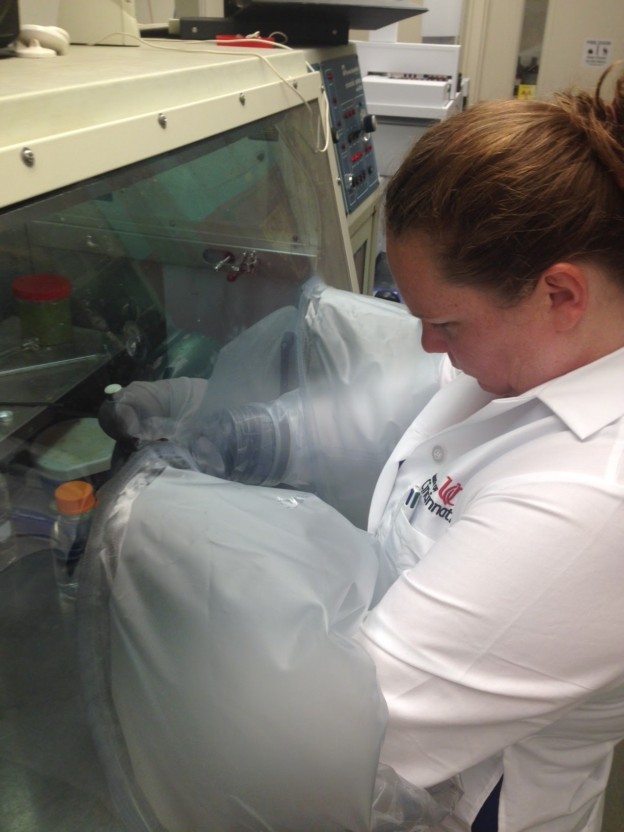
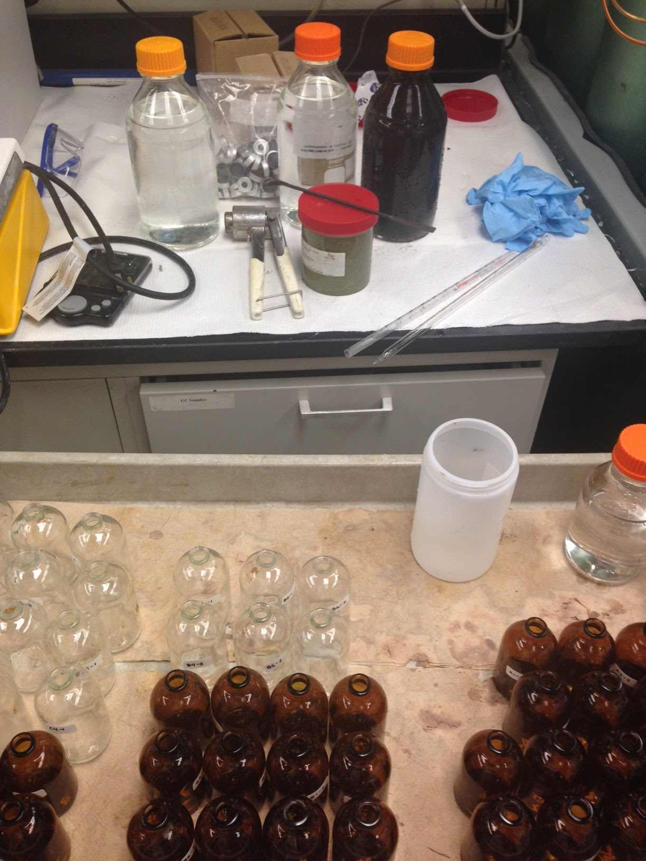
Research Tasks
Anaerobic Chamber
95% Nitrogen
5% Hydrogen
Prepared Overnight
No Oxygen

Slide 10
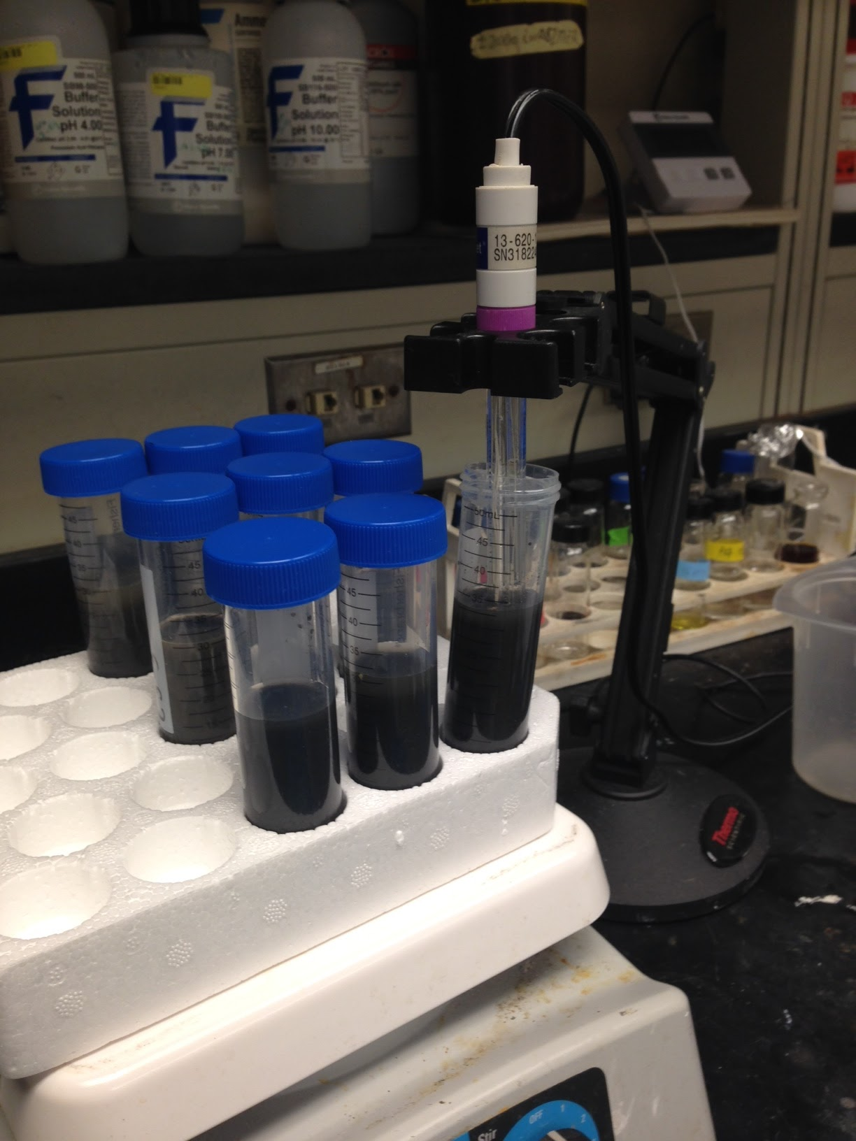
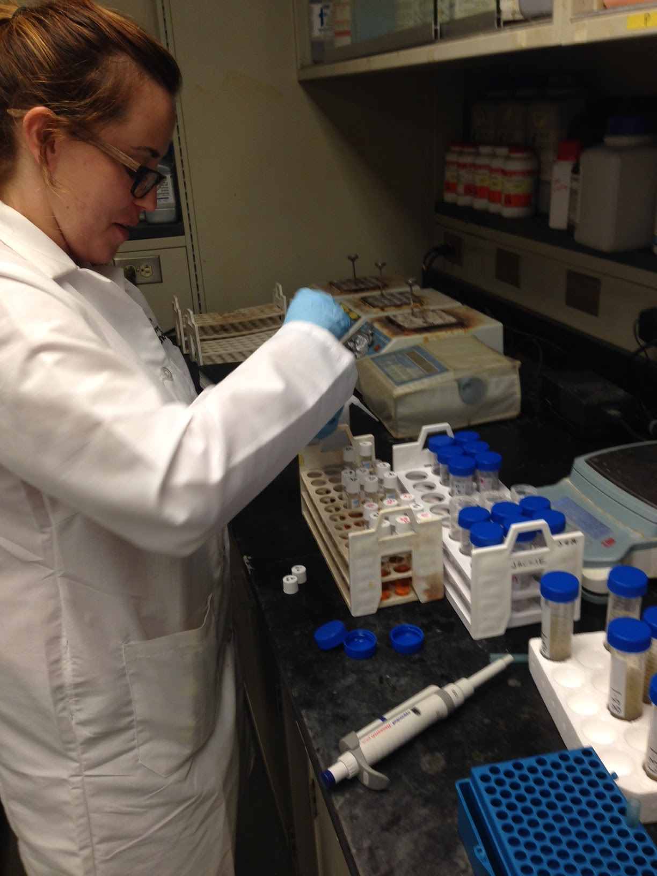
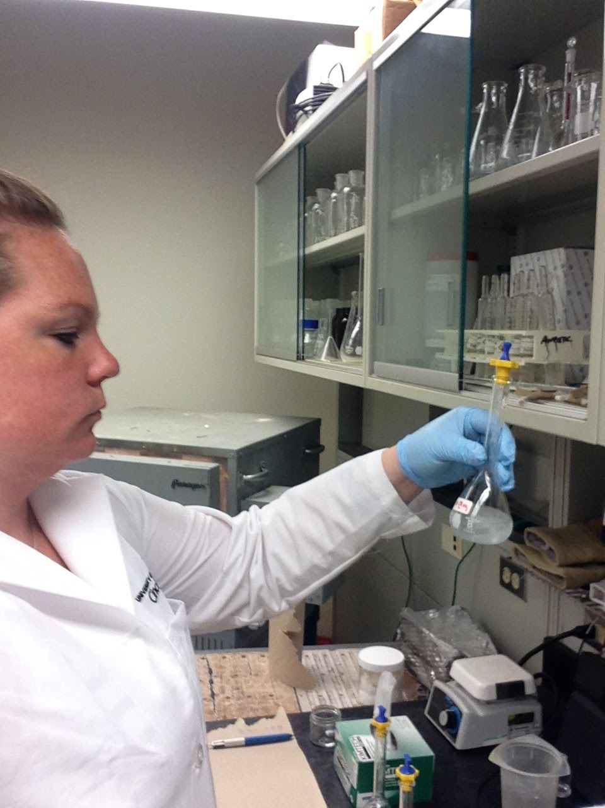
Research Tasks

Slide 11
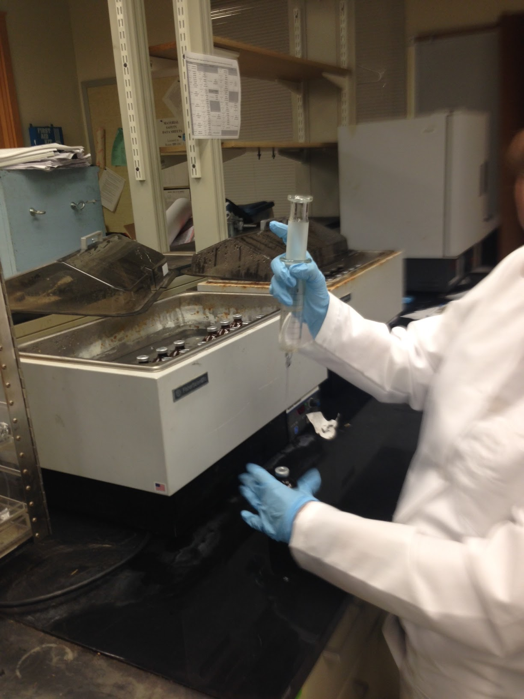
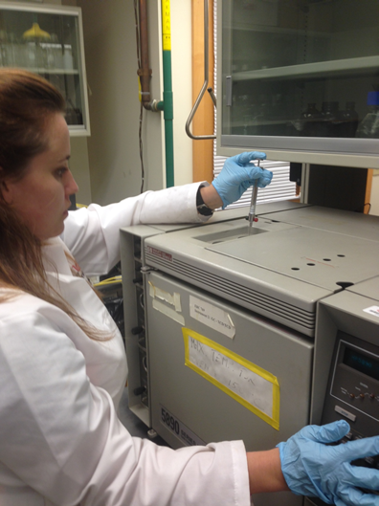
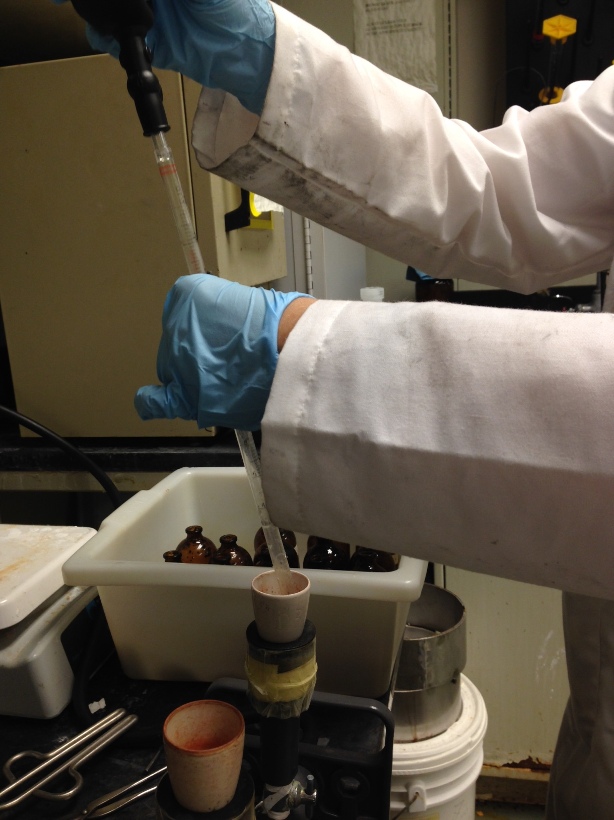
Research Tasks

Slide 12
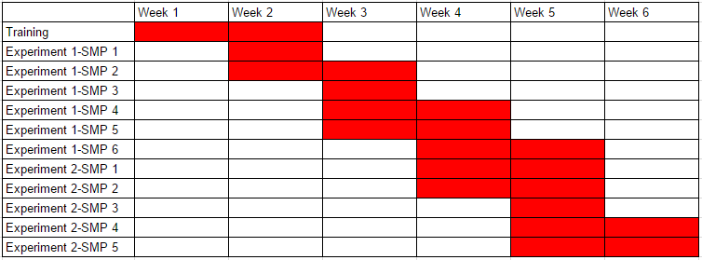
Timeline

Slide 13
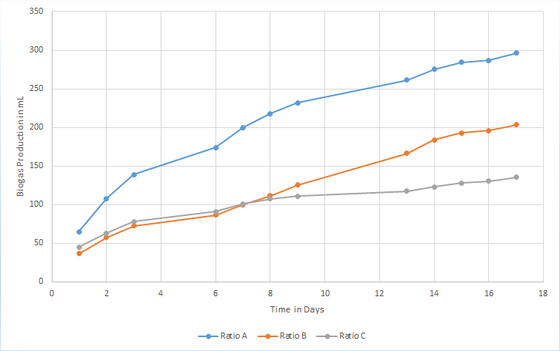
Gas Production

Slide 14
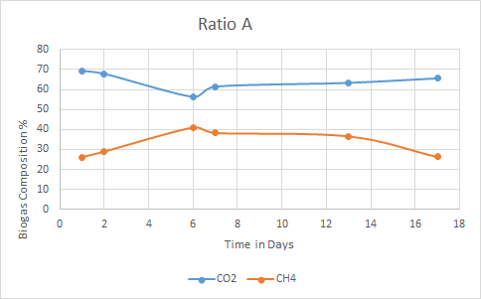
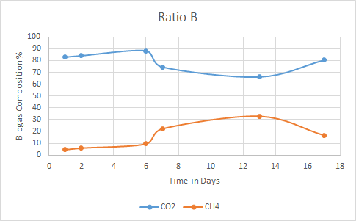
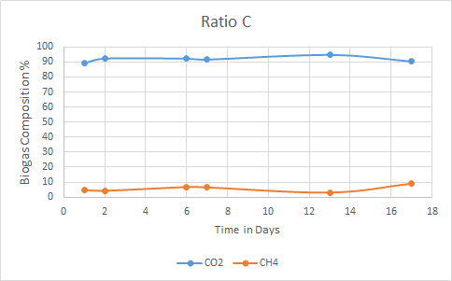
Biogas Composition

Slide 15
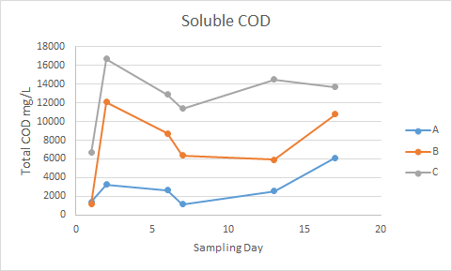
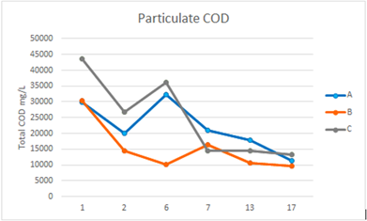
Chemical Oxygen Demand

Slide 16
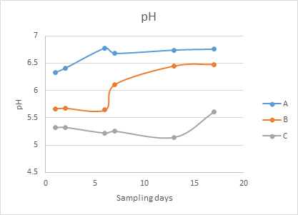
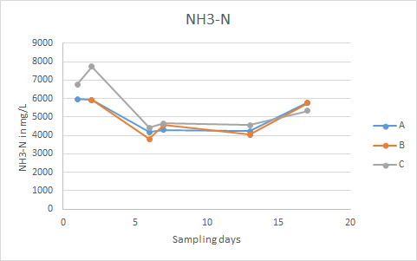
pH and Ammonia

Slide 17
Unit Plan Richmond
Subject: 11th-12th Grade Biochemistry
Unit Topic: Physical and Chemical Properties
Big Idea: Waste Disposal and Separation
Essential Questions: How can we use Physical and Chemical Properties to sort trash?

Slide 18
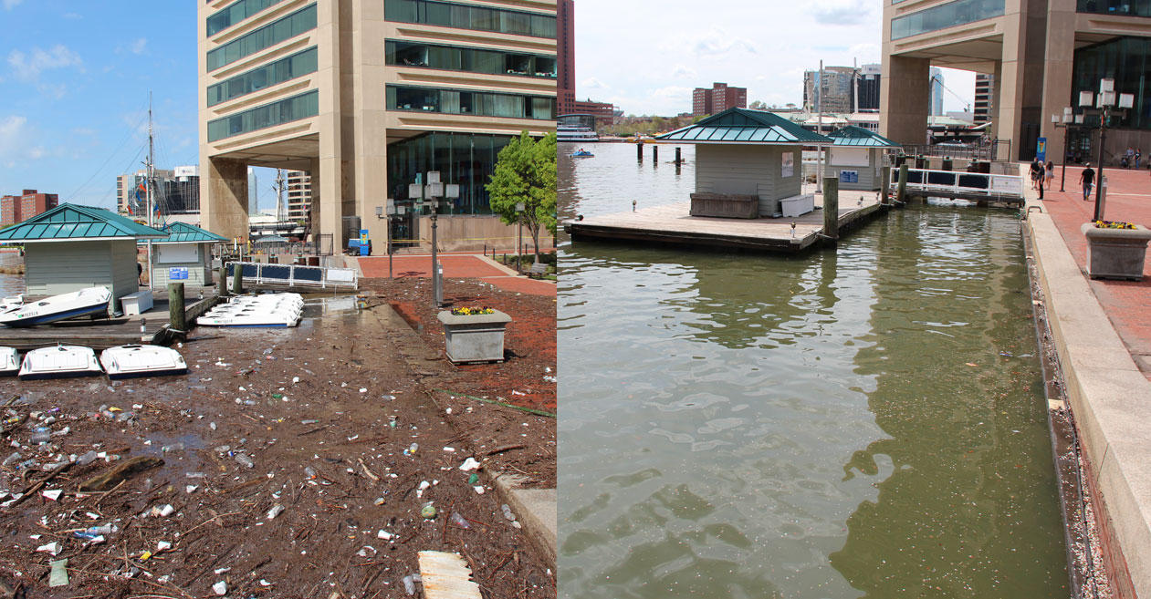
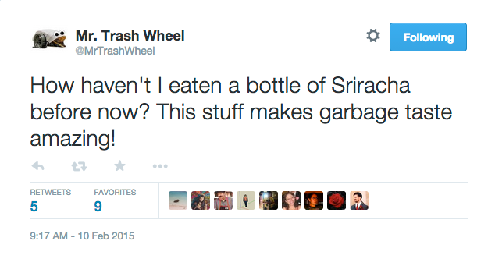
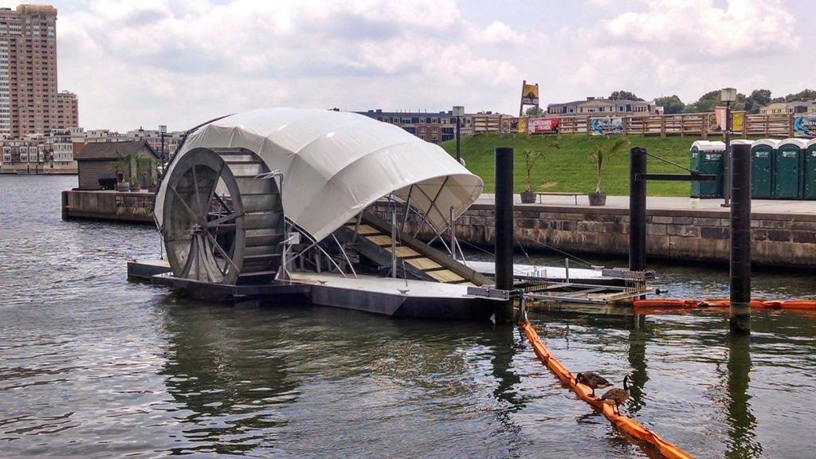
Hook: Mr. Trash

Slide 19
Activity 2 and 3
Activity 2: Webquest on Physical and Chemical Changes and Properties
Activity 3: Home Study on the amount and types of trash students produce

Slide 20
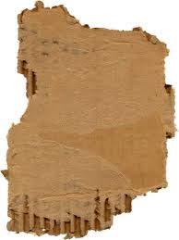
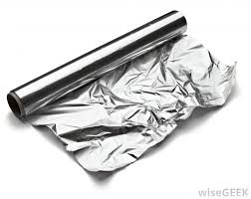
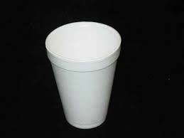
Challenge
Design a process to sort out six different materials by using their physical or chemical properties

Slide 21
Unit Plan Hoffman
Unit Topic: Waste Management and Climate Change
Big Idea: Waste Management
Essential Question: How can we eliminate waste in landfills while using the byproducts sustainably?

Slide 22
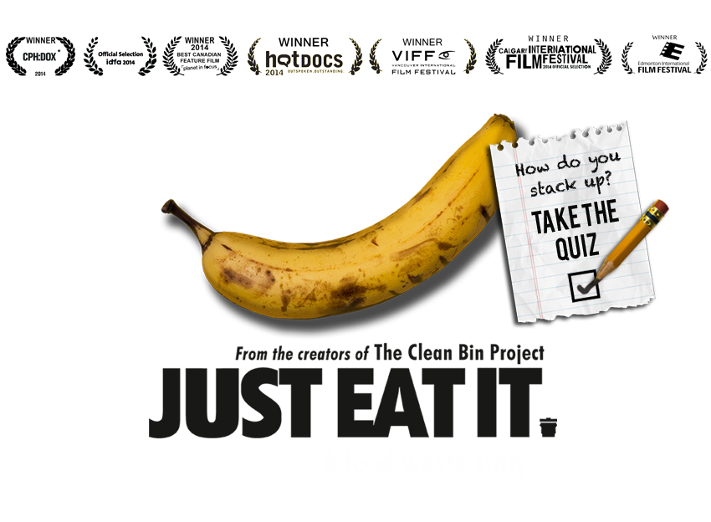
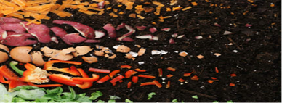
Unit Plan: Hoffman
The Hook: Students will watch the documentary Just Eat it, a food waste story
Activity 1: Composting and Waste EPA WebQuest
Activity 2: Macrorganism Discovery Lab and Mature Compost Analysis
The Challenge: Design a small batch compost container and analyze the progress of the compost, making adjustments as measurements are taken.
http://www.foodwastemovie.com/about/

